Slide 1
Interfaces, JUnit
#05 Finish them

Slide 2

Notes:
Добавить один уровень астракции оказалось сложнее, чем написать кучку ифов и свичей.

Slide 3


Slide 4
AutoClosable
package java.lang;
public interface AutoCloseable {
void close() throws Exception;
}

Slide 5
IClosable
public interface IClosable
extends AutoCloseable {
}

Slide 6
IClosable
public interface IClosable
extends AutoCloseable {
@Override
void close() throws CloseException;
}

Slide 7


Slide 8
Catch
} catch (Exception e) {
e.printStackTrace();
}
Don't do this!

Slide 9
Catch
} catch (Exception e) {
throw new FormatterException(
"Format failed", e);
}

Slide 10
Catch
} catch (Exception e) {
logger.error("Format failed", e);
}

Slide 11
Reader
public boolean hasChar() {
buf.mark(1);
int c = buf.read();
buf.reset();
return c != -1;
}

Slide 12
mark() & reset()
Class | markSupported()
java.io.Reader | true if and only if this stream supports the mark operation
java.io.FileReader | false
java.io.StringReader | true
java.io.CharArrayReader | true
java.io.BufferedReader | true
java.io.InputStreamReader | false (even over BufferedInputStream)

Slide 13
Concatenation
String s = "a";
s += "b";
s += "c";

Slide 14
Concatenation
L0
LINENUMBER 9 L0
LDC "a"
ASTORE 1
L1
LINENUMBER 10 L1
NEW java/lang/StringBuilder
DUP
INVOKESPECIAL java/lang/StringBuilder.<init> ()V
ALOAD 1
INVOKEVIRTUAL java/lang/StringBuilder.append (Ljava/lang/String;)Ljava/lang/StringBuilder;
LDC "b"
INVOKEVIRTUAL java/lang/StringBuilder.append (Ljava/lang/String;)Ljava/lang/StringBuilder;
INVOKEVIRTUAL java/lang/StringBuilder.toString ()Ljava/lang/String;
ASTORE 1
L2
LINENUMBER 11 L2
NEW java/lang/StringBuilder
DUP
INVOKESPECIAL java/lang/StringBuilder.<init> ()V
ALOAD 1
INVOKEVIRTUAL java/lang/StringBuilder.append (Ljava/lang/String;)Ljava/lang/StringBuilder;
LDC "c"
INVOKEVIRTUAL java/lang/StringBuilder.append (Ljava/lang/String;)Ljava/lang/StringBuilder;
INVOKEVIRTUAL java/lang/StringBuilder.toString ()Ljava/lang/String;
ASTORE 1

Slide 15
.gitignore
*.iml
.idea
target

Slide 16
JAR
<build>
<plugins>
<plugin>
<groupId>org.apache.maven.plugins</groupId>
<artifactId>maven-jar-plugin</artifactId>
<configuration>
<archive>
<manifest>
<mainClass>it.sevenbits.courses.formatter.App</mainClass>
</manifest>
</archive>
</configuration>
</plugin>
</plugins>
</build>

Slide 17
Executable JAR
$ mvn package
$ java -jar target/formatter-1.0-SNAPSHOT \
in.java out.java

Slide 18
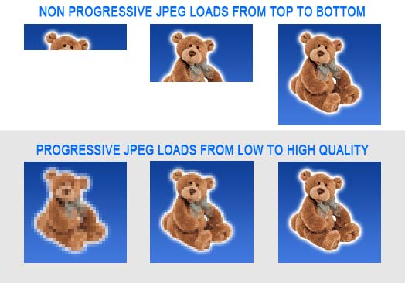
Progressive JPEG

Slide 19
Progressive JPEG
Do the form
  Infrastructure
  Interfaces
  Dummy implementation
Fill the form
  Smarter implementations

Slide 20
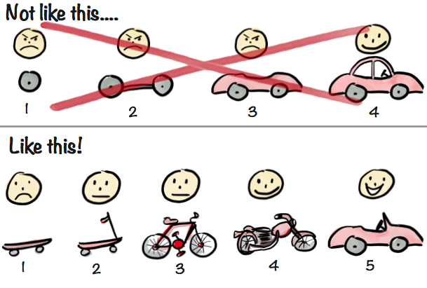
Minimal Viable Product (MVP)

Slide 21
Checklist
Correct project structure, packages, .gitignore
IReader, IWriter interfaces
String IO implementation
Formatter uses IReader, IWriter
>3 JUnit tests of Formatter
<10 CheckStyle warnings
File IO Implementation, IClosable
main() uses File IO, opens and closes files
Maven builds the project
Runs successfully with java -jar

Slide 22
Homework
Complete the checklist
  Including running as java -jar
Add IFormatter
  The existing Formatter must implement it
Make a Lexer
  Reads the text
  Extracts significant lexemes
  Outputs lexemes
  https://en.wikipedia.org/wiki/Lexical_analysis

Slide 23
Homework
To: denis.nelubin@7bits.it
Cc: back-teachers@7bits.it
Subj: Java Homework #05
Deadline: Sunday 23:59 (midnight)
https://7bits-courses.slack.com/messages/C7R2R4AMB/

